Slide 1

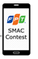
Architecture: Motor Routing

Slide 2
Architecture: Motor Routing
1a. Text Search

Slide 3

Architecture: Motor Routing
1b. Voice Search
1a. Text Search

Slide 4
Architecture: Motor Routing
1b. Voice Search
1a. Text Search

Slide 5
Architecture: Motor Routing
1b. Voice Search
1c. Text
1a. Text Search

Slide 6

Architecture: Motor Routing
Google Map API
1b. Voice Search
1c. Text
1a. Text Search

Slide 7
Architecture: Motor Routing
Google Map API
1b. Voice Search
1c. Text
2. Request motor route
1a. Text Search

Slide 8
Architecture: Motor Routing
Google Map API
1b. Voice Search
1c. Text
2. Request motor route
3. List results
1a. Text Search

Slide 9
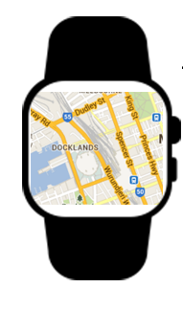
Architecture: Motor Routing
Google Map API
1b. Voice Search
1c. Text
2. Request motor route
3. List results
1a. Text Search
Android Wear

Slide 10
Architecture: Motor Routing
Google Map API
1b. Voice Search
1c. Text
2. Request motor route
3. List results
1a. Text Search
3. Sync data when on street
Android Wear

Slide 11

Architecture: Motor Routing
Google Map API
1b. Voice Search
1c. Text
2. Request motor route
3. List results
1a. Text Search
3. Sync data when on street
Android Wear
Text To Speech API

Slide 12
Architecture: Motor Routing
Google Map API
1b. Voice Search
1c. Text
2. Request motor route
3. List results
1a. Text Search
3. Sync data when on street
4. Request sound files
Android Wear
Text To Speech API

Slide 13
Architecture: Motor Routing
Google Map API
1b. Voice Search
1c. Text
2. Request bus route
3. List results
1a. Text Search
3. Sync data when on street
5. Sound files
4. Request sound files
Android Wear
Text To Speech API

